Slide 1


K.RAMAKRISHNAN COLLEGE OF TECHNOLOGY (AUTONOMOUS), TRICHY
Analysing Traffic Data on a Busy Road Using R
PRESENTED BY
SUGAPRIYA A -2303811724322112

Slide 2
PRESENTATION OVERVIEW
Problem Identification
Objective
Proposed system
Block diagram of proposed system
Machine learning used
Advantages of Proposed System
List of Modules
Implementation
Conclusion

Slide 3
PROBLEM IDENTIFICATION
Traffic congestion is a major issue in urban areas, leading to delays, increased fuel consumption, and pollution. Understanding traffic patterns can help in optimizing road usage, managing traffic signals, and improving overall transportation efficiency.
Challenges:
High traffic volume leading to congestion.
Need for real-time monitoring and prediction.
Impact of external factors like weather, accidents, and road conditions.
2/7/20

Slide 4
OBJECTIVE
The objective of this project is to analyze traffic data using R to:
Monitor traffic flow patterns.
Identify congestion-prone areas.
Predict peak hours and traffic trends.
Visualize data using graphs and heatmaps.
Suggest possible solutions for better traffic management.

Slide 5
DATA SCIENCE RELATTED CONCEPTS USED
Time Series Forecasting (for Traffic Flow Prediction):
ARIMA (AutoRegressive Integrated Moving Average)
Best for time-series data like hourly/daily traffic volume.
Handles trends and seasonality well.
Suitable for historical traffic data analysis.
2. Supervised Learning (for Traffic Congestion Classification):
Random Forest (RF)
Works well for classifying congestion levels.
Can handle multiple factors (time, weather, road type, etc.).

Slide 6
DATA SCIENCE RELATTED CONCEPTS USED
3. Unsupervised Learning (for Hotspot Detection):
K-Means Clustering
Groups locations with similar congestion patterns.
Helps find recurring bottlenecks.

Slide 7
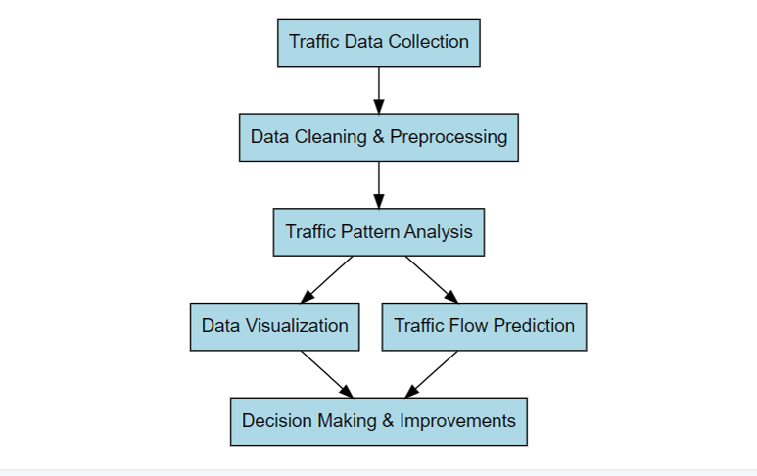
BLOCK DIAGRAM

Slide 8
ADVANTAGES OF PROPOSED SYSTEM
Accurate Traffic Prediction: Using ARIMA/Prophet, the system forecasts future congestion trends, helping traffic authorities and commuters plan ahead.
Real-Time Congestion Detection: Random Forest classifies traffic levels (Low, Medium, High), enabling quick response measures like adjusting signal timings.
Hotspot Identification for Better Traffic Management : K-Means Clustering detects frequently congested areas, assisting in optimizing road infrastructure and rerouting strategies.
Data-Driven Decision Making for Smart Cities: The system provides insights based on historical and real-time data, improving urban traffic planning and reducing delays.

Slide 9
LIST OF MODULES
1. Data Collection & Preprocessing
2. Exploratory Data Analysis (EDA)
3. Time Series Analysis & Forecasting
4. Spatial Analysis & Heatmaps

Slide 10
MODULES DESCRIPTION
1. Data Collection & Preprocessing
Read data from sources (CSV, APIs, IoT sensors).
Clean missing values and remove anomalies.
Libraries: readr, dplyr, tidyverse.
2. Exploratory Data Analysis (EDA)
Summary statistics and visualization.
Traffic flow trends using line plots and histograms.
Libraries: ggplot2, ggpubr.

Slide 11
MODULES DESCRIPTION
3. Time Series Analysis & Forecasting
Detect peak traffic hours..
Predict future congestion trends.
Libraries: forecast, prophet, tseries.
4. Spatial Analysis & Heatmaps
Identify congestion hotspots using geospatial data.
Libraries: caret, randomForest.

Slide 12
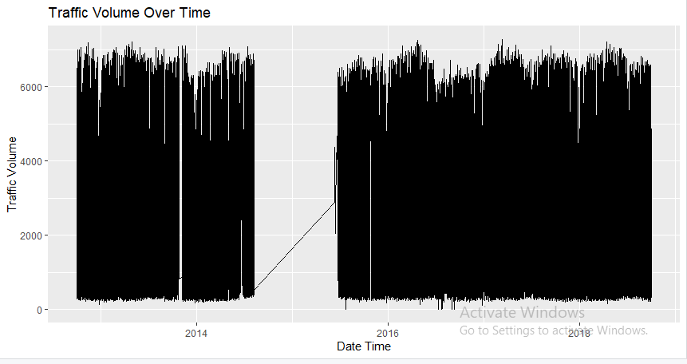
IMPLEMENTATION

Slide 13
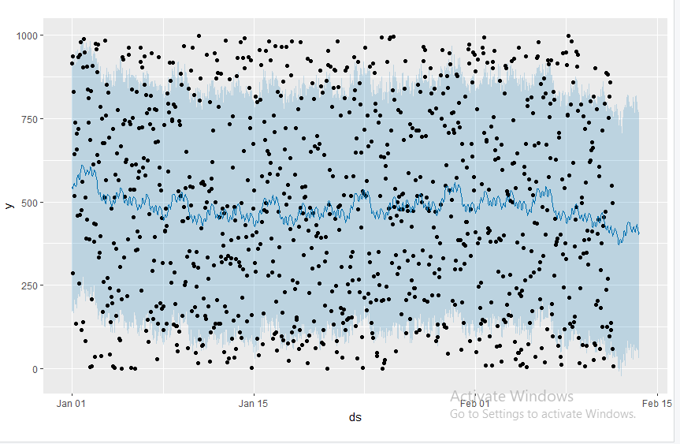
IMPLEMENTATION

Slide 14
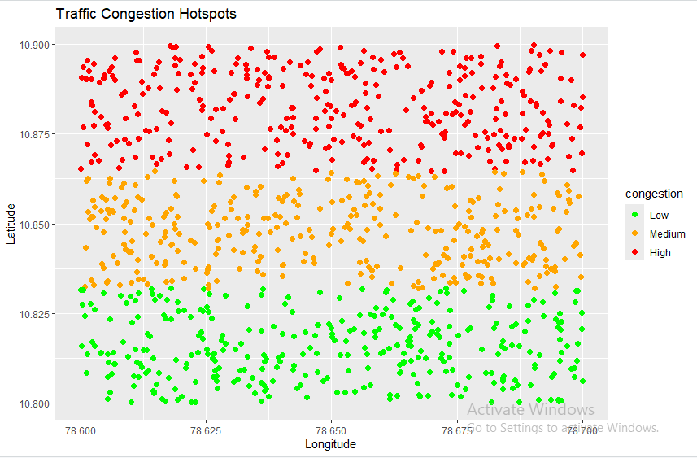
IMPLEMENTATION

Slide 15
CONCLUSION
This project effectively analyzed urban traffic patterns using R through a combination of data preprocessing, exploratory analysis, time series forecasting, and machine learning. Key insights revealed peak traffic during weekday rush hours, weather-dependent fluctuations, and recurring congestion hotspots identified using K-Means clustering. ARIMA models successfully forecasted traffic volume trends, while Random Forest classified congestion levels based on multiple features. The findings demonstrate the potential of data-driven approaches to enhance urban traffic management, offering valuable inputs for smarter infrastructure planning, real-time traffic control, and improved commuter experience.

Slide 16
THANK YOU

